Slide 1
Japanese Internment in WWII
Executive Order 9066 through Korematsu v. United States (1984)

Slide 2
Timeline of the Process of Internment and Release—Part I
1941
  July–August
    As the Japanese government expands its war with China (begun in 1937) into Southeast Asia, the United States embargoes trade with Japan (including oil and scrap metal) and freezes Japanese assets.
  December 7
    In a surprise attack, Japanese naval aircraft bomb the United States Pacific Fleet at Pearl Harbor, on the island of Oahu, Hawaii, sinking four battleships, severely damaging four others, killing 2,340 servicemen, and wounding 1,143 others. President Roosevelt issues Proclamation 2525, which requires Japanese aliens to register as enemies of the state.
  December 8
    The U.S. Congress declares war on Japan; President Roosevelt issues Proclamation 2526 and Proclamation 2527, which require German and Italian aliens to register as enemies of the state.

Slide 3
Timeline of the Process of Internment and Release
1942
  February 19
    President Roosevelt signs Executive Order 9066.
  March 2
    Lt Gen John DeWitt issues Public Proclamation 1, which declares CA, OR, WA, and southern Arizona “military areas” and states that all persons of Japanese ancestry will be evacuated.
  March 18
    President Roosevelt signs Executive Order 9102, which creates the War Relocation Authority.
  March 21
    Congress passes Public Law 503, which adds criminal sanctions, penalties, and other enforcement powers to Executive Order 9066.
  May 20
    94,330 evacuees are in assembly or relocation centers, 2,342 are being moved, and 3,035 have received orders to evacuate within the next ten days.

Slide 4
Executive Order 9066 Prescribes Military Areas Within the U.S (1942)
Whereas the successful prosecution of the war requires every possible protection against espionage and against sabotage to national-defense material, national-defense premises, and national defense utilities. . . .
Now, therefore, by virtue of the authority vested in me as President of the United States, and Commander in Chief of the Army and Navy, I hereby authorize and direct the Secretary of War, and the Military Commanders whom he may from time to time designate, whenever he or any designated commander deems such action necessary or desirable, to prescribe military areas in such places and of such extent as he or the appropriate Military Commander may determine, from which any or all persons may be excluded, and with respect to which, the right of any person to enter, remain in, or leave shall be subject to whatever restrictions the Secretary of War or the appropriate Military Commander may impose in his discretion. The Secretary of War is hereby authorized to provide for residents of any such area who are excluded therefrom, such transportation, food, shelter, and other accommodations as may be necessary, in the judgment of the Secretary of War or the said Military Commander, and until other arrangements are made, to accomplish the purpose of this order. . . .
I hereby further authorize and direct the Secretary of War and the said Military Commanders to take such other steps as he or the appropriate Military Commander may deem advisable to enforce compliance with the restrictions applicable to each Military area herein-above authorized to be designated, including the use of Federal troops and other Federal Agencies with authority to accept assistance of state and local agencies.
I hereby further authorize and direct all Executive Departments, independent establishments and other Federal Agencies, to assist the Secretary of War or the said Military Commanders in carrying out this Executive Order, including the furnishing of medical aid, hospitalization, food, clothing, transportation, use of land, shelter, and other supplies, equipment, utilities, facilities, and services.

Slide 5
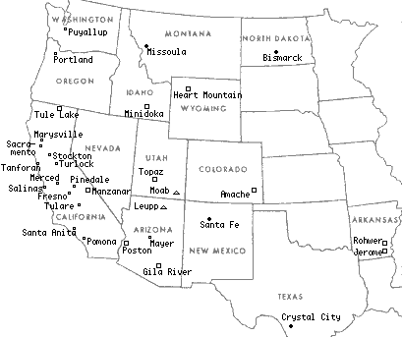
Locations of the Camps

Slide 6
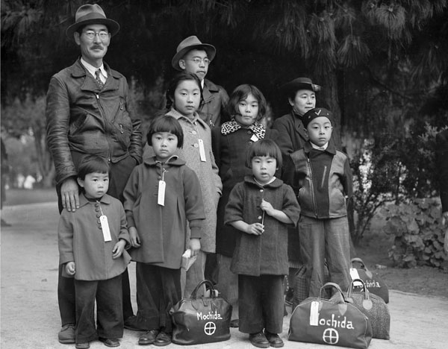
The Mochida Family---Members of the Mochida family awaiting evacuation bus. Identification tags were used to aid in keeping a family unit intact during all phases of evacuation. Mochida operated a nursery and five greenhouses on a two-acre site in Eden Township.

Slide 7
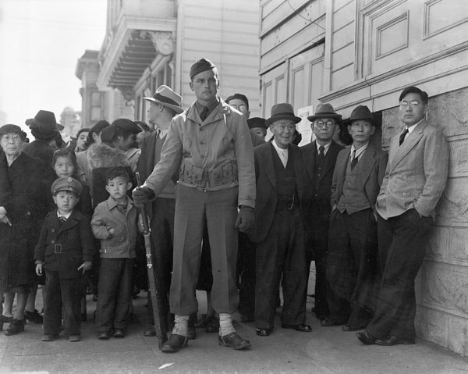
"A crowd of onlookers on the first day of evacuation from the Japanese quarter in San Francisco, who themselves will be evacuated within three days."
By Dorothea Lange, San Francisco, California, April 1942

Slide 8
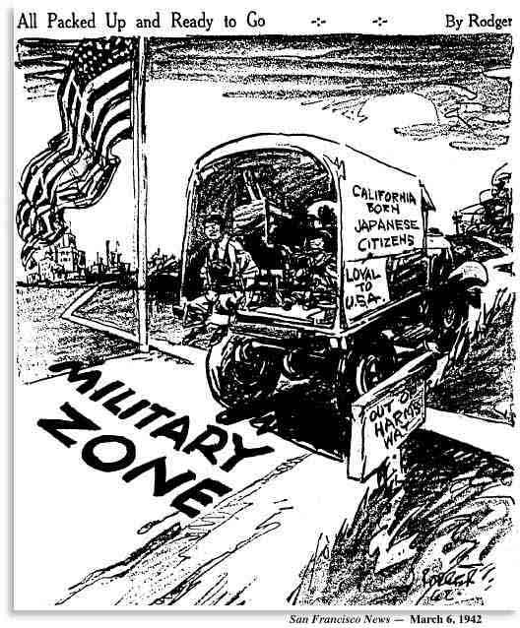
San Francisco News, March 6, 1942

Slide 9
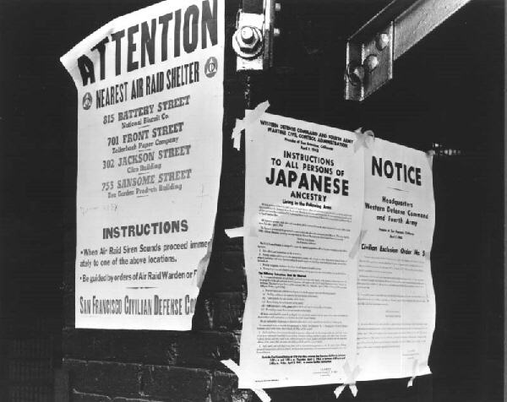
Notice to Evacuate

Slide 10
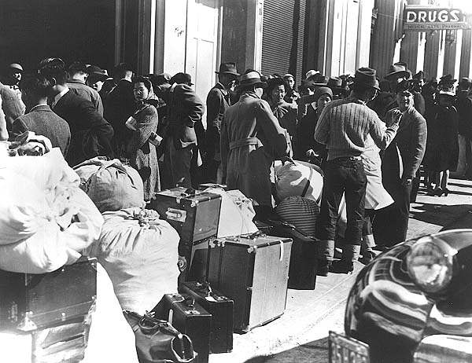
Awaiting Transfer—Van Ness Avenue, April 1942

Slide 11
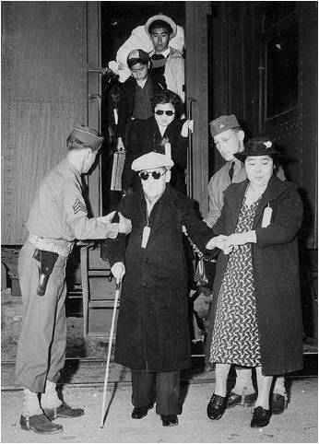
War Relocation Authority

Slide 12
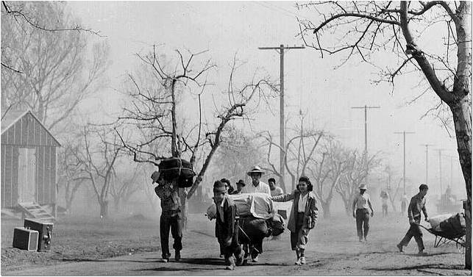
Moving to Manzanar

Slide 13
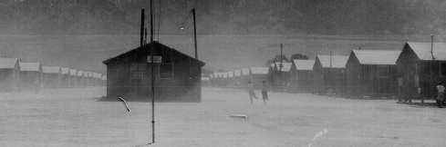
Manzanar

Slide 14
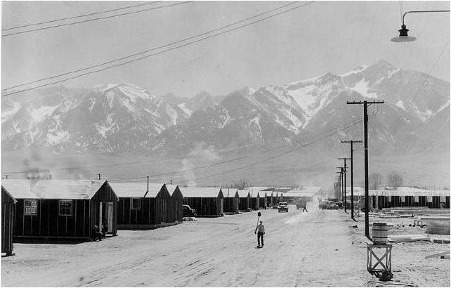
Manzanar

Slide 15
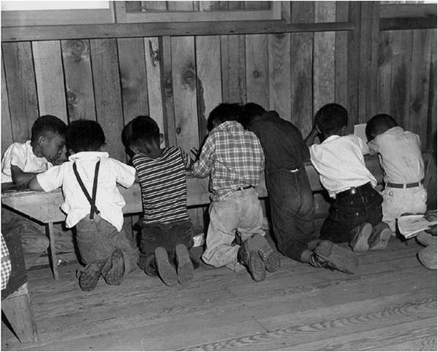
Manzanar—3rd Graders doing Math…

Slide 16
Timeline of the Process of Internment and Release
1943
  June 21
    Supreme Court upholds curfew and exclusion orders.
1945
  January 2
    Public Proclamation 21 rescinds the mass exclusion ordered under Executive Order 9066 and allows the 85,000 evacuees who remain in the camps to return home.
1948
  July 2
    President Harry S. Truman signs the Japanese-American Evacuation Claims Act, providing about $28 million in limited compensation for economic losses because of the evacuation.

Slide 17
Legitimacy of Internment
Hirabayahsi v. United States (1943)
  Upheld the constitutionality of curfews for people of Japanese descent
  1986-1987 Seattle US District Court overturns both convictions
Korematsu v. United States (1944)
  Upheld the constitutionality of Executive Order 9066
  Protection against espionage was more important than individual rights
  1984 Northern California US District Court grants writ of coram nobis—voiding Korematsu’s conviction

Slide 18
Legacy of Internment
Estimated $200,000,000 in lost personal and commercial property lost
Severe disruption to established Japanese American culture
  Issei—devalued at camps
  Nissei—given responsibility over elders
  Lost businesses
  $16 per month earned for a 44 hour work week
    10 cents per hour—meal costs were 15 cents per meal
1948 American Japanese Claims Act
1988 Civil Liberties Act
  Awards $20,000 to each living former detainee

Slide 19
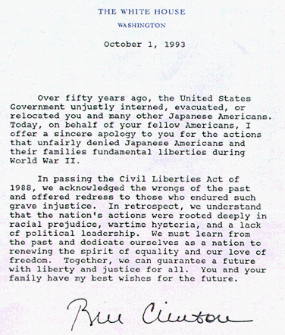
1993 Letter by Bill Clinton

